Slide 1
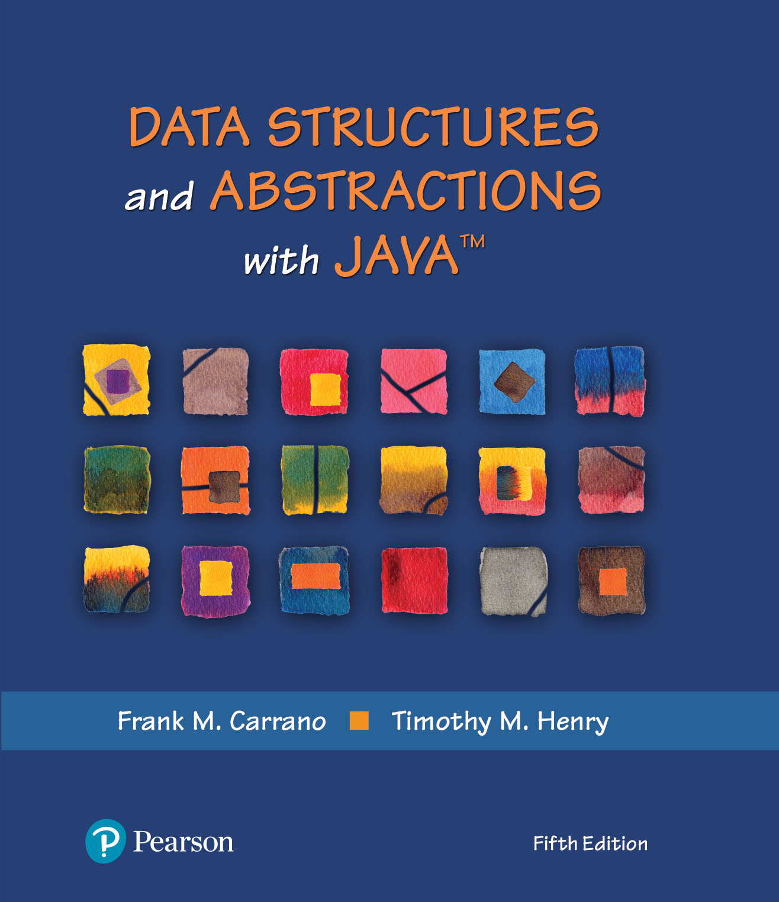
Data Structures and Abstractions with Java™
5th Edition
Module 6 – Efficiency of Algorithms
Using:
Chapter 4 - The Efficiency of Algorithms

Slide 2
Why Efficient Code?
Computers are faster, have larger memories
So why worry about efficient code?
And … how do we measure efficiency?

Slide 3

Importance of Efficiency
Consider the problem of summing
Algorithm A | Algorithm B | Algorithm C
long sum = 0; for (long i = 1; i <= n; i++) sum = sum + i; | sum = 0; for (long i = 1; i <= n; i++) { for (long j = 1; j <= i; j++) sum = sum + 1; } // end for | sum = n * (n + 1) / 2;
FIGURE 4-1
Three algorithms for computing the sum 1 + 2 + . . . + n for an integer n > 0

Slide 4
What is “best”?
An algorithm has both time and space constraints – that is complexity
Time complexity
Space complexity
This study is called analysis of algorithms

Slide 5
Counting Basic Operations
A basic operation of an algorithm
Most significant contributor to its total time requirement
 | Algorithm A | Algorithm B | Algorithm C
 | long sum = 0; for (long i = 1; i <= n; i++) sum = sum + i; | sum = 0; for (long i = 1; i <= n; i++) { for (long j = 1; j <= i; j++) sum = sum + 1; } // end for | sum = n * (n + 1) / 2;
Additons | n | n(n + 1)/2 | 1
Multiplications | 0 | 0 | 1
Divisions | 0 | 0 | 1
Total Basic Operations | n | (n² + n)/2 | 3
FIGURE 4-2 The number of basic operations required by the algorithms

Slide 6
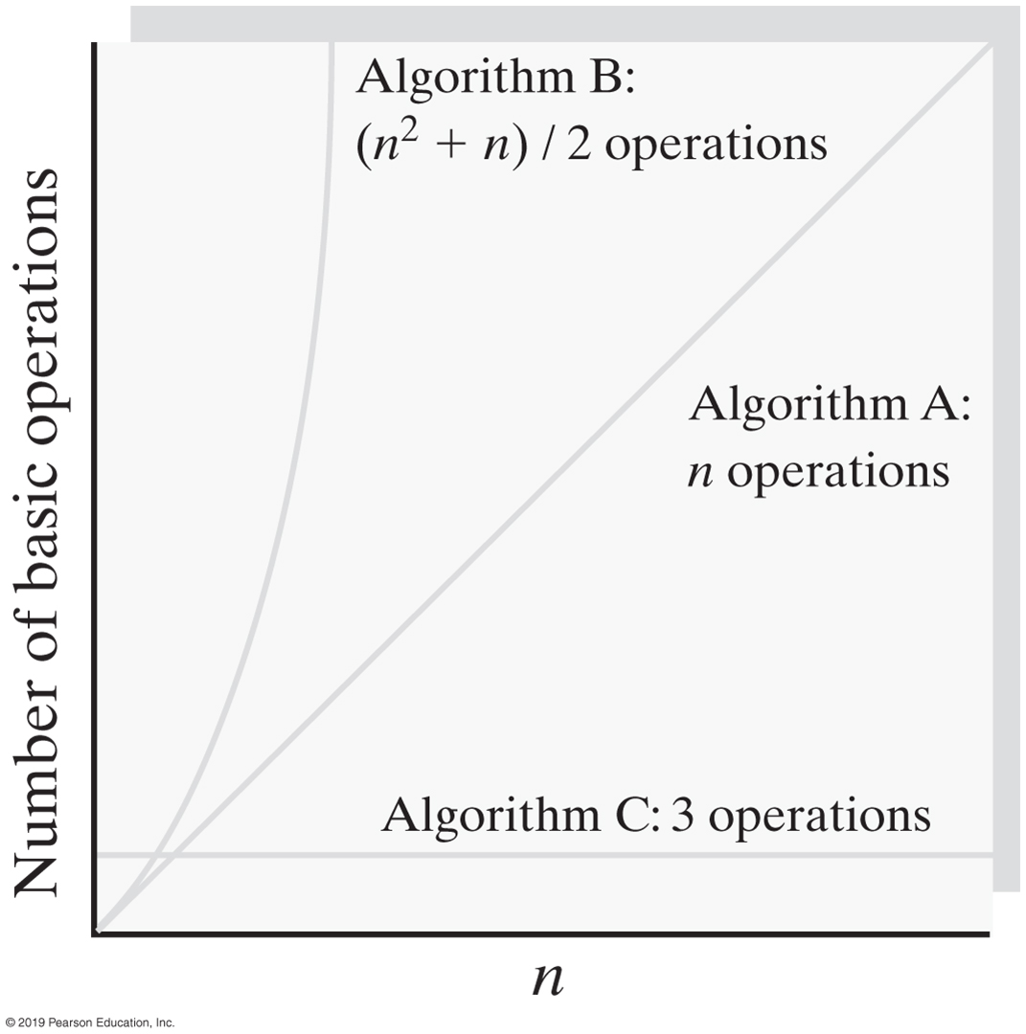
Counting Basic Operations
FIGURE 4-3 Number of basic operations required by the algorithms as a function of n

Slide 7
Counting Basic Operations
n | (log(log n) | log n | log² n | n | n log n | n² | n³ | 2^{n} | n!
10 | 2 | 3 | 11 | 10 | 33 | 10² | 10³ | 10³ | 10⁵
10² | 3 | 7 | 44 | 100 | 664 | 10⁴ | 10⁶ | 10³⁰ | 10⁹⁴
10³ | 3 | 10 | 99 | 1,000 | 9,966 | 10⁶ | 10⁹ | 10³⁰¹ | 10¹⁴³⁵
10⁴ | 4 | 13 | 177 | 10,000 | 132,877 | 10⁸ | 10¹² | 10³⁰¹⁰ | 10^{19,335}
10⁵ | 4 | 17 | 276 | 100,00 | 1,660,964 | 10¹⁰ | 10¹⁵ | 10^{30,103} | 10^{243,338}
10⁶ | 4 | 20 | 397 | 1,000,000 | 19,931,569 | 10¹² | 10¹⁸ | 10^{301,301} | 10^{2,933,369}
FIGURE 4-4 Typical growth-rate functions evaluated at increasing values of n

Slide 8
Best, Worst, and Average Cases
For some algorithms, execution time depends only on size of data set
Other algorithms depend on the nature of the data itself
Goal is to know best case, worst case, average case

Slide 9
Big Oh Notation
A function f(n) is of order at most g(n)
That is, f(n) is O(g(n)) — if
A positive real number c and positive integer N exist …
Such that f(n) ≤ c x g(n) for all n ≥ N
That is:
c x g(n) is an upper bound on f(n) when n is sufficiently large

Slide 10
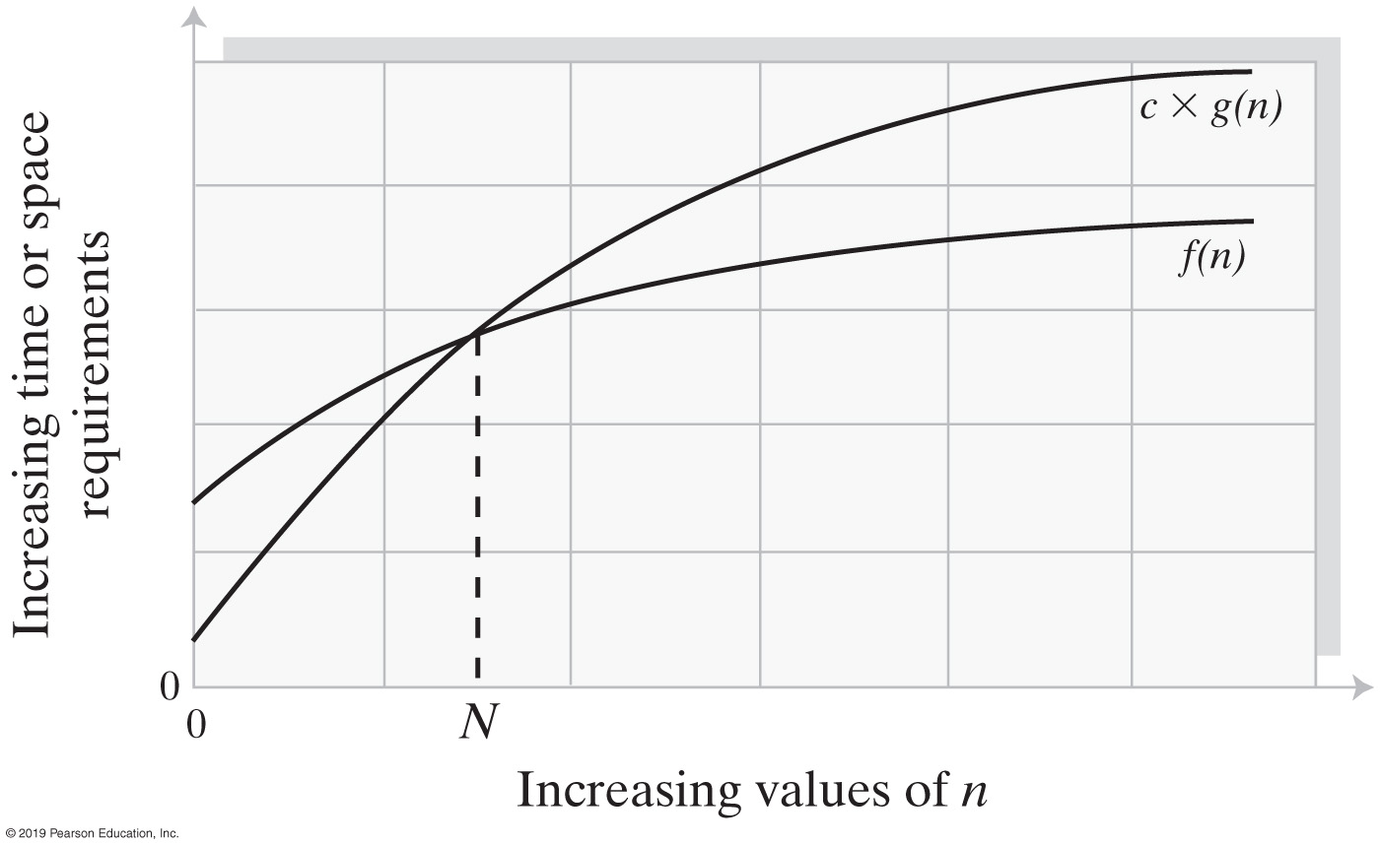
Big Oh Notation
FIGURE 4-5 An illustration of the values of two growth-rate functions

Slide 11
Big Oh Notation
O(k g(n)) = O(g(n)) for a constant k
O(g 1 (n)) + O(g 2 (n)) = O(g 1 (n) + g 2 (n))
O(g 1 (n)) * O(g 2 (n)) = O(g 1 (n) * g 2 (n))
O(g 1 (n) + g 2 (n) + . . . + g m (n)) =
O(max(g 1 (n), g 2 (n), . . ., g m (n))
O(max(g 1 (n), g 2 (n), . . ., g m (n)) =
max(O(g 1 (n)), O(g 2 (n)), . . ., O(g m (n)))
Identities for Big Oh Notation

Slide 12
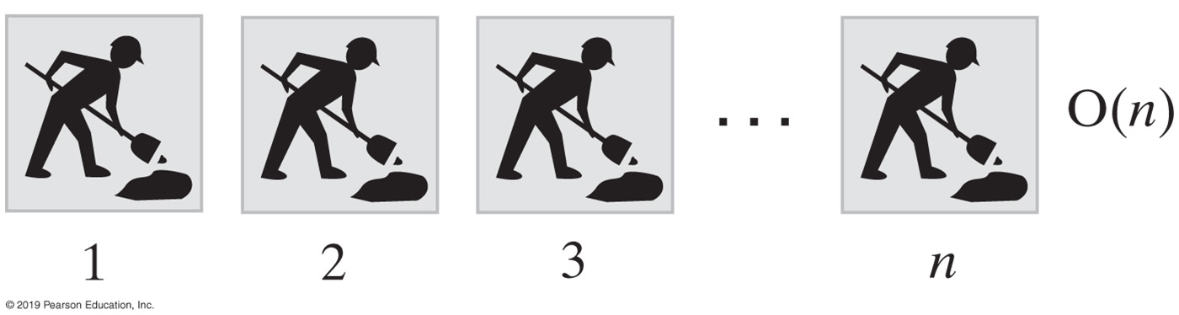
Picturing Efficiency
long sum = 0;
for (long i = 1; i <= n; i++)
sum = sum + i;
FIGURE 4-6 An O(n) algorithm

Slide 13
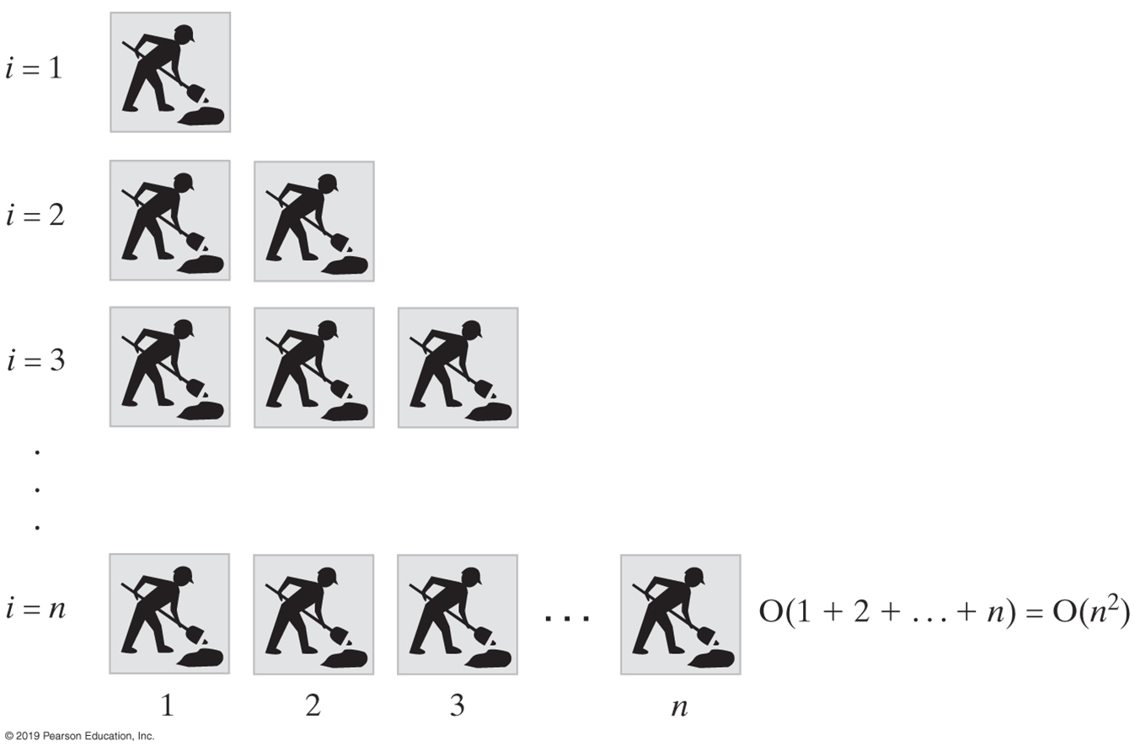
Picturing Efficiency
sum = 0;
for (long i = 1; i <= n; i++)
{
for (long j = 1; j <= i; j++)
sum = sum + 1;
} // end for
FIGURE 4-7 An O(n²) algorithm

Slide 14
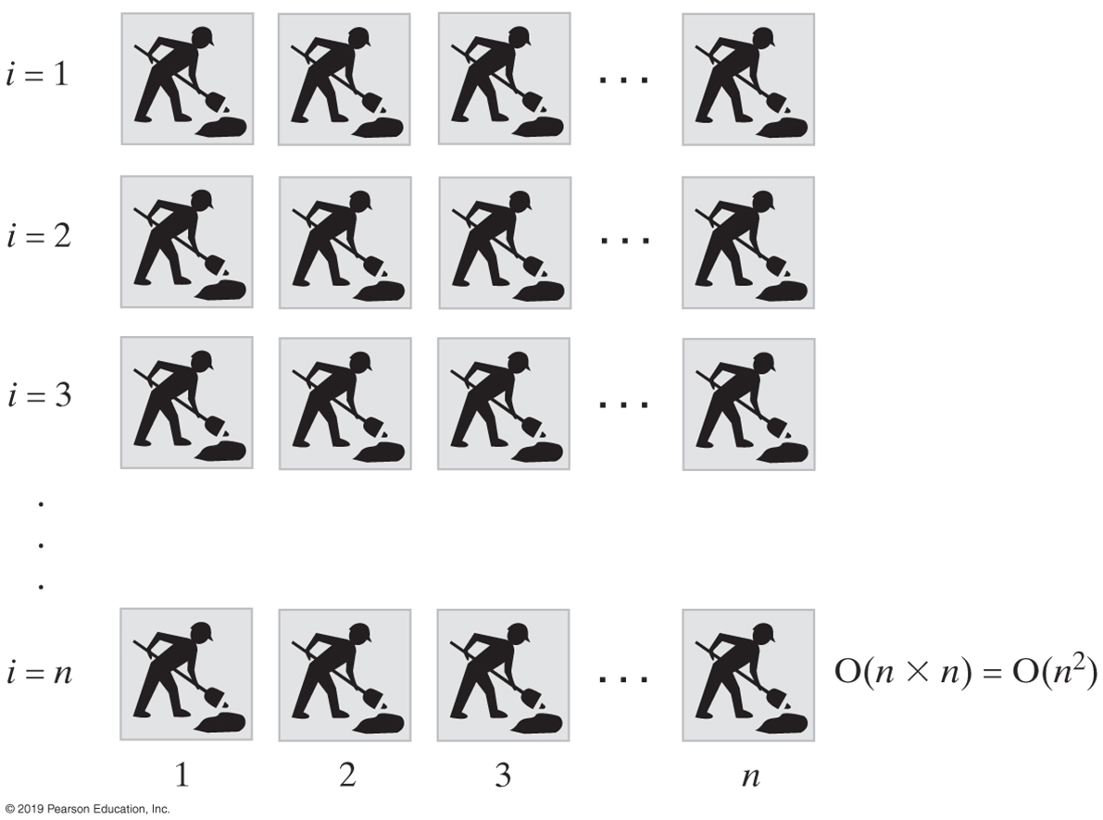
Picturing Efficiency
sum = 0;
for (long i = 1; i <= n; i++)
{
for (long j = 1; j <= n; j++)
sum = sum + 1;
} // end for
FIGURE 4-8 Another O(n²) algorithm

Slide 15
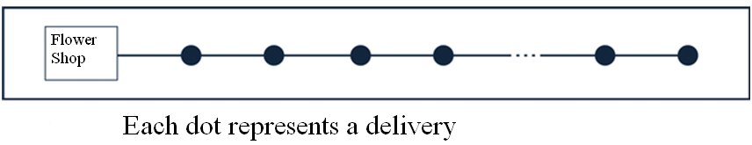

Picturing efficiency: another example
A flower shop has multiple deliveries to make. What algorithm
should they use?

Slide 16
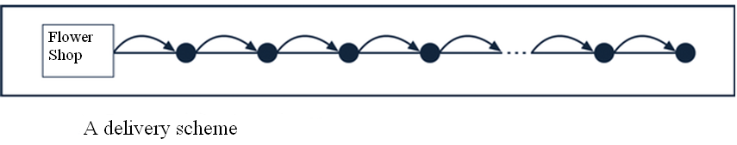
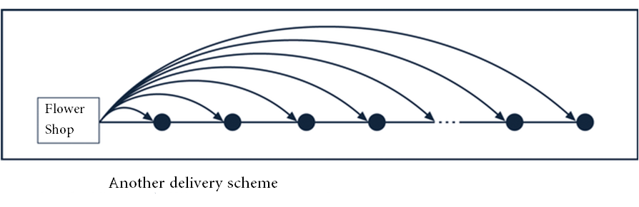
Picturing efficiency: another example

Slide 17
Picturing Efficiency
Growth-Rate Function for Size n Problems | Growth-Rate Function for Size 2n Problems | Effect on Time Requirement
1 | 1 | None
log n | 1 + log n | Negligible
n | 2n | Doubles
n log n | 2n log n + 2n | Doubles and then adds 2n
n² | (2n)² | Quadruples
n³ | (2n)³ | Multiples by 8
2^{n} | 2^{2n} | Squares
FIGURE 4-9 The effect of doubling the problem size on an algorithm’s time requirement

Slide 18
Picturing Efficiency
Growth-Rate Function g | g(10⁶) / 10⁶
log n | 0.0000199 seconds
n | 1 second
n log n | 19.9 seconds
n² | 11.6 days
n³ | 31,709.8 years
2^{n} | 10^{301,016} years
FIGURE 4-10 The time required to process one million items by algorithms of various orders at the rate of one million operations per second

Slide 19
Efficiency of ADT Bag Implementations
Operation | Fixed-Size Array | Linked
add(newEntry) | O(1) | O(1)
remove() | O(1) | O(1)
remove(anEntry) | O(1), O(n), O(n) | O(1), O(n), O(n)
clear() | O(n) | O(n)
getFrequencyOf(anEntry) | O(n) | O(n)
contains(anEntry) | O(1), O(n), O(n) | O(1), O(n), O(n)
toArray() | O(n) | O(n)
getCurrentSize(), isEmpty() | O(1) | O(1)
FIGURE 4-11 The time efficiencies of the ADT bag operations for two implementations, expressed in Big Oh notation

Slide 20
Common Algorithm Complexity Terms

Slide 21
Comparison of Growth Rates of Common Algorithm Complexity Terms

Slide 22
Relative Algorithm Speed Analysis Technique
Look for the inner most nested loop
Determine the maximum number of times this loop executes as a function of n, the maximum value of the loop variable(s). (For data structures, n is often the number of nodes in the structure)
The Big-Oh value of the function is the relative speed
For example, the binary search algorithm is O(log2n)

Slide 23
Binary Search Algorithm
low = 0;
high = n - 1
i = (high - low) / 2;
while (searchValue != data[i] && high != low)
{ if(searchValue < data[i])
{ high= i - 1 } // move high down to eliminate the upper half of the sub-array
else
{ low = i + 1 } // move low up to eliminate the lower half of the sub list
i = (high + low) / 2;
}
If n is the size of the array, the while loop executes a maximum of log₂(n-1) times

Slide 24
Determination of the Maximum Number of Times the Binary Search Loop Executes
Generalizing T = log2n

Slide 25
Examples of Common Algorithm Complexity

Slide 26
Constant - O(1)
O(1) describes an algorithm that will always execute in the same time (or space) regardless of the size of the input data set.
bool IsFirstElementNull(String[] strings)
{
if(strings[0] == null)
{
return true;
}
return false;
}
Rob Bell
A beginners Guide to Big O Notation
rob-bell.net/2009/06/a-beginners-guide-to-big-o-notation/
Notes:
Big

Slide 27
Linear - O(N)
O(N) describes an algorithm whose performance will grow linearly and in direct proportion to the size of the input data set. The example below also demonstrates how Big O favours the worst-case performance scenario; a matching string could be found during any iteration of the for loop and the function would return early, but Big O notation will always assume the upper limit where the algorithm will perform the maximum number of iterations.
bool ContainsValue(String[] strings, String value)
{
for(int i = 0; i < strings.Length; i++)
{
if(strings[i] == value)
{
return true;
}
} return false;
}
Rob Bell
A beginners Guide to Big O Notation
rob-bell.net/2009/06/a-beginners-guide-to-big-o-notation/

Slide 28
Polynomial - O(N²)
O(N²) represents an algorithm whose performance is directly proportional to the square of the size of the input data set. This is common with algorithms that involve nested iterations over the data set. Deeper nested iterations will result in O(N³), O(N⁴) etc.
bool ContainsDuplicates(String[] strings)
{
for(int i = 0; i < strings.Length; i++)
{
for(int j = 0; j < strings.Length; j++)
{
if(i == j) // Don't compare with self
{
continue;
}
if(strings[i] == strings[j])
{
return true;
}
}
}
return false;
}
Rob Bell
A beginners Guide to Big O Notation
rob-bell.net/2009/06/a-beginners-guide-to-big-o-notation/

Slide 29
Exponential - O(2^{N})
O(2^{N}) denotes an algorithm whose growth will double with each additional element in the input data set. The execution time of an O(2^{N}) function will quickly become very large.
Rob Bell
A beginners Guide to Big O Notation
rob-bell.net/2009/06/a-beginners-guide-to-big-o-notation/

Slide 30
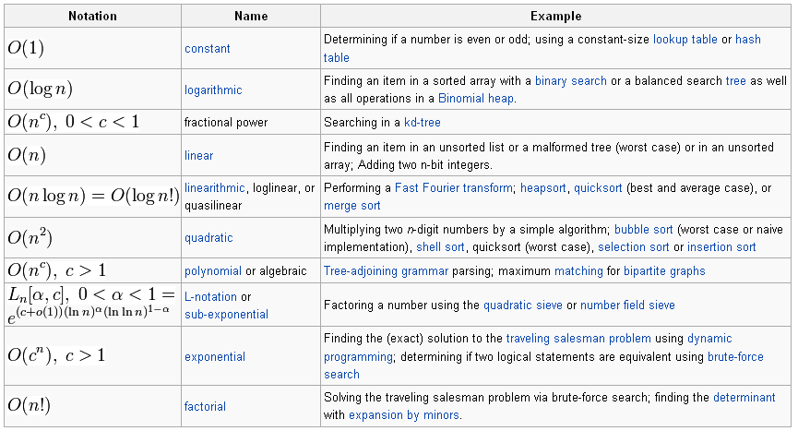
Orders of common functions Here is a list of classes of functions that are commonly encountered when analyzing the running time of an algorithm. In each case, c is a constant and n increases without bound. The slower-growing functions are generally listed first.
From Wikipedia, the free encyclopedia

